Slide 2
COMP1206 - Programming 2
Lecture: File I/O
Dr Jian Shi
Jian.Shi@soton.ac.uk
25 February 2020

Slide 3
Topics
Persistent data
File Class in Java
Streams in Java

Slide 4
Persistent Data
Much of data is stored temporarily in Java objects and data structures
Consequently, such data will be lost.
To resolve this issue --> make the data persistent.
Writing into a local file on a local disk
Writing it across the network
Connecting to a database
Etc.

Slide 5
File Structure
In Java, every file is considered as a sequential stream of bytes which is terminated with a special ‘end-of-file’ marker byte.
Compare this with the possibly complex structure involved in a Java object. The data stored in objects can be highly organized and grouped in very particular ways.
There is clearly a big mismatch between the simple view of files as streams and the complex data structures of objects.
Some flattening of these object structures is clearly going to be necessary in order to store them in a file. This is what is known as serialization.
Of course, in order to read a flattened object back from a file we will need to deserialize it.

Slide 6
File Class
A java.io.File object is an abstract representation of a file or directory of the underlying OS.
File Class is the ONLY class related to the file itself within the entire io package.
i.e. by using File Class, developers could do common operations including creating files, deleting files, etc.
Creating a File object does NOT create or open a file in the underlying OS, it simply provides a means of addressing one in Java, in a platform independent way. File objects are used as sources and targets of input and output streams to actually transfer data to and from disk.

Slide 7
File Class - Constructors
There are a number of constructors for this class, the most useful one
File (String pathname)
This constructor takes the string ‘pathname’ and converts it in to an OS pathname and associates the constructed File object with a file at that path. A variant of this constructor allows you to separately specify the path to the file and the file name itself. Another variant allow you to specify URIs.
There are methods in the class to explore the file in the case it is a directory.

Slide 8
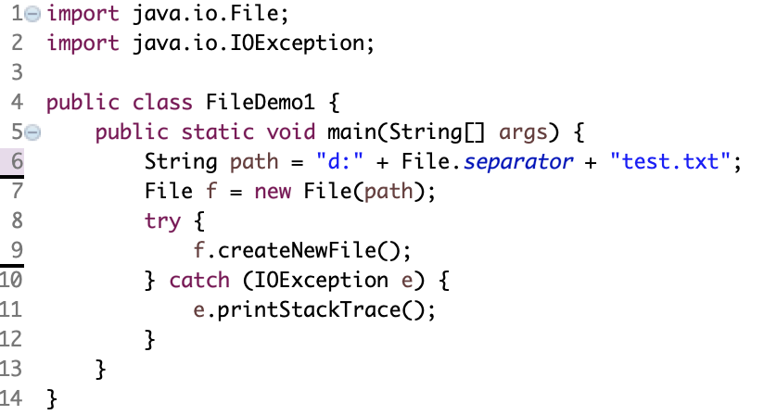
File Class – Creating Files
Example:
Notes:
File Separator:
Windows - \
Linux - /
Create a directory?
Line 9 -> f.mkdir()
Delete a file?
Line 9 -> f.delete()

Slide 9
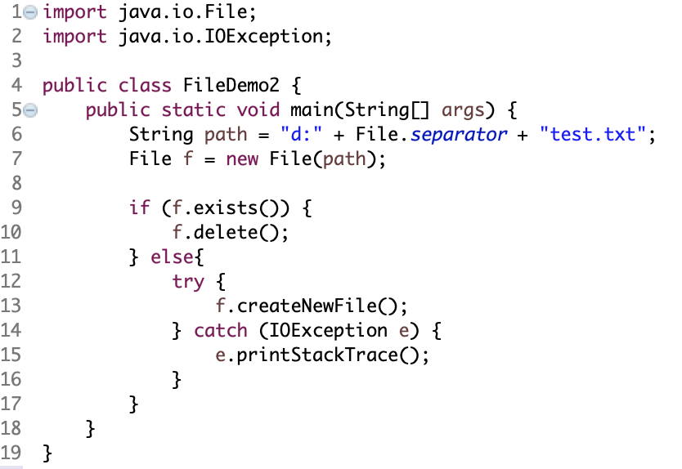
File Class – Creating and Deleting Files (Example)
File Object
true
false
Exist?
Delete
Create

Slide 10
File Choosers
Reading and Writing character data (strings) or bytes to a file is provided for using the various stream classes.
Addressing files in the underlying file system is done using File objects – provided that you know the path name or the file you wish to access.
Of course, your experience of accessing files would usually be through a GUI window in which you can browse directories and select(possibly multiple) files.
This is such a common GUI component that it would be ridiculous to implement it yourself for each application.
Swing to the rescue!
javax.swing.JFileChooser is a very high - level GUI component which implements exactly the functionality described above: it allows the user to select a file by browsing the local file system using a GUI window.
It’s made easy for you. Think about how you would implement this component!

Slide 11
Input and Output Streams
The sequential stream of bytes structure used in file storage may seem too simplistic and one wonders whether a more structured persistent data mechanism would be better.
Fundamentally though, you need to get the structured information in and out of memory. Whether the data is being written to disk or sent across a network, at OS level, the data will always end up as stream of bytes (and then bits).
So like it or not, persistent data, squeezed through some I/O mechanism, is essentially a stream of bytes.
One advantage of treating a file as a stream of bytes though is that any client software accessing a file from a disk can use the same I/O interface as if it were receiving the same stream of bytes across the network.
That is to say, a stream of bytes is a sufficiently abstract model of data (due to its simplicity) to allow us to uniformly treat network I/O, standard I/O (keyboard input, output to screen), file I/O.

Slide 12
Streams in Java
We are using streams as our model of data to be inputted or outputted.
java.io.InputStream
java.io.OutputStream
These are abstract classes which encapsulate the operations common to all input/output stream objects. The latter of these is the simpler of the two: there are methods which write byte values in to the stream
write(int b) writes the 8 low-order bits of b to the stream
write(byte[] b) writes the whole type array b to the stream

Slide 13
Streams in Java
Input Streams are more sophisticated. There are methods for reading single bytes, as well as byte arrays, but also methods for skipping over portions of the streams, setting a marker in the stream and then resetting the current position for reading back to the last marked byte.
In practice, we use concrete subclasses of these classes which implement the read and write methods in various ways.
These classes relate to byte-based streams. Java also supports character-based steams which are more convenient to use for strings. These are typically referred to as Reader and Writer.

Slide 14
Byte-based Stream & Character-based Stream
Byte-based
OutputStream & InputStream
Character-based
Reader & Writer
Main steps for Java I/O Operation
Get a file ready with File Class
Set up stream
Read or Write
Close the input/output stream

Slide 15
Byte-based Stream
The OutputStream Class Hierarchy
OutputStream
ByteArrayOutputStream
PipedOutputStream
FileOutputStream
ObjectOutputStream
FilterOutputStream
PrintStream
BufferedOutputStream
DataOutputStream
InputStream is similar with the same types of concrete instances, e.g. BufferedInputStream
These stream types are suitable for sending byte-based data.

Slide 16
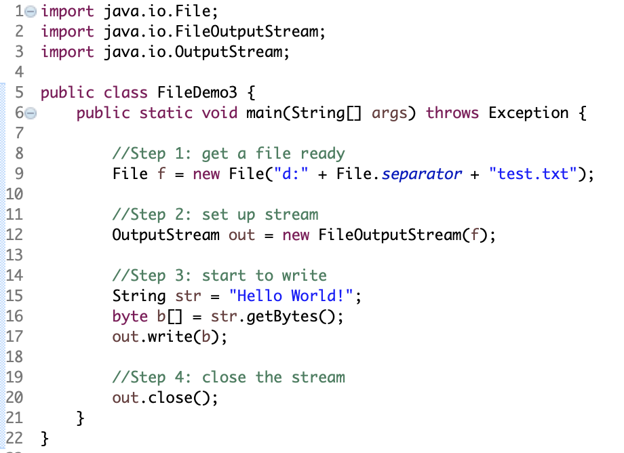
Byte-based Output Stream
Notes:
If the file doesn’t exist, then create one
Line 12 -> xxx(f, true) means appending new content from the end of the file
New line? -> \r\n

Slide 17
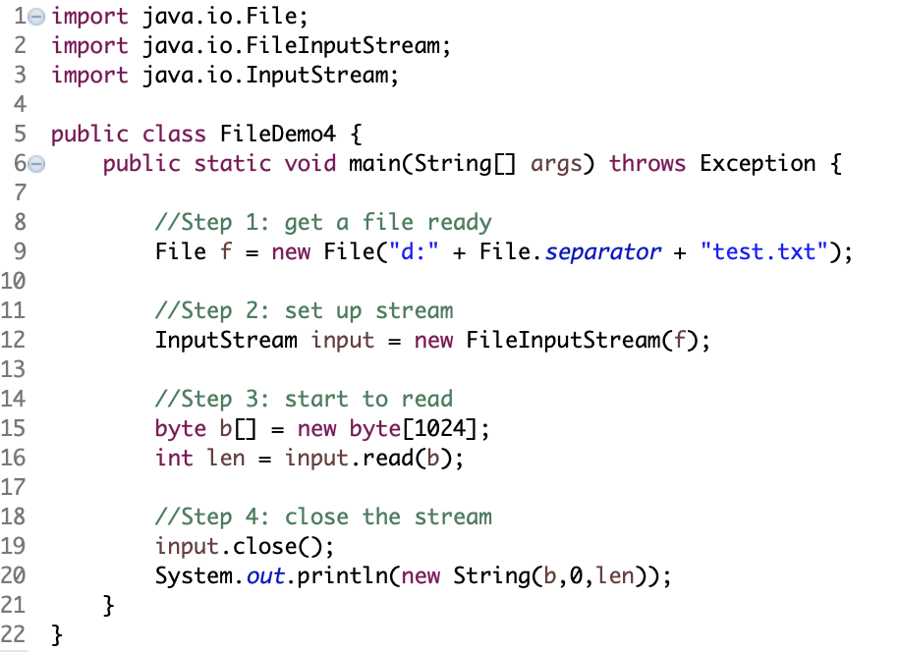
Byte-based Input Stream
read the byte array, meanwhile, return the total number of bytes read

Slide 18
Character-based Stream
Many applications involving reading and writing strings (or character-based data).
There is an entirely separate hierarchy of I/O classes for this purpose.
They are referred to as Reader and Writer.
The Writer Class Hierarchy
Writer
FilterWriter
PrintWriter
StringWriter
BufferedWriter
CharArrayWriter
PipedWriter
OutputStreamWriter
FileWriter

Slide 19
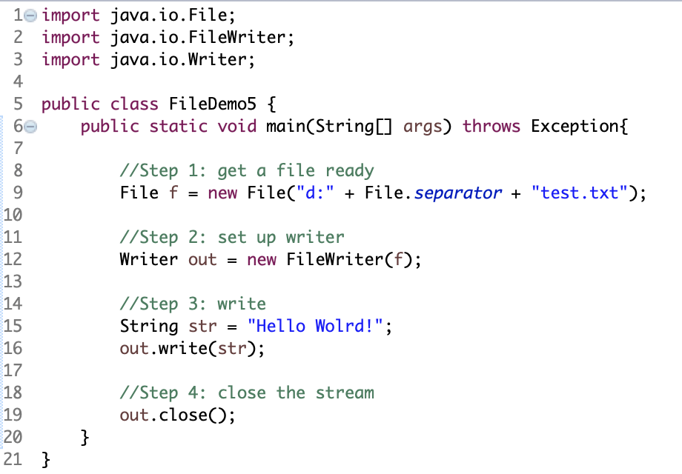
Character-based Writer Stream
Notes:
File doesn’t exist
create one
File exists
overwrite
Append to the existing file
line 12 -> FileWriter(f, true)

Slide 20
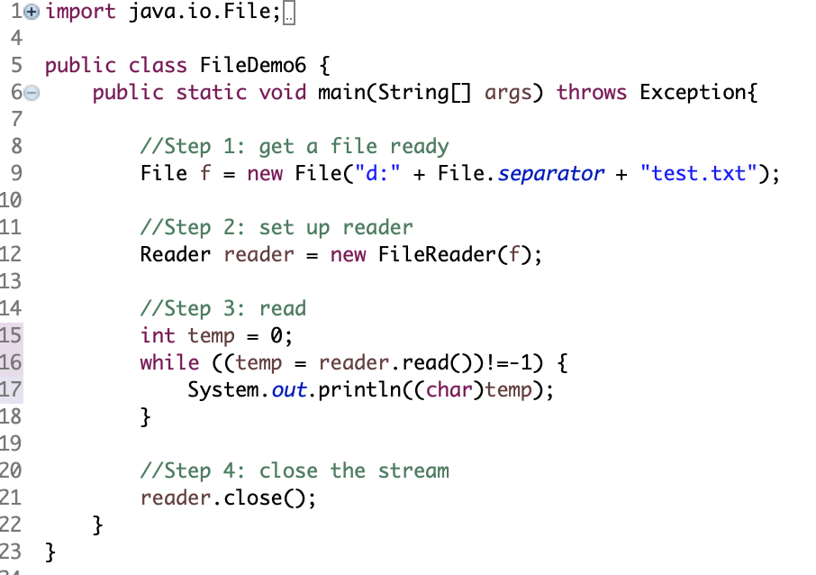
Character-based Reader Stream
Notes:
read() in line 16 returns: The character read, or -1 if the end of the stream has been reached

Slide 21
Byte-based V.S. Character-based
code
Byte-based Stream
file
code
Char-based Stream
Buffer (memory)
file

Slide 22
More Streams
ByteArray Stream
Pipeline Stream
Print Stream
Filter Stream
Etc.

Slide 23
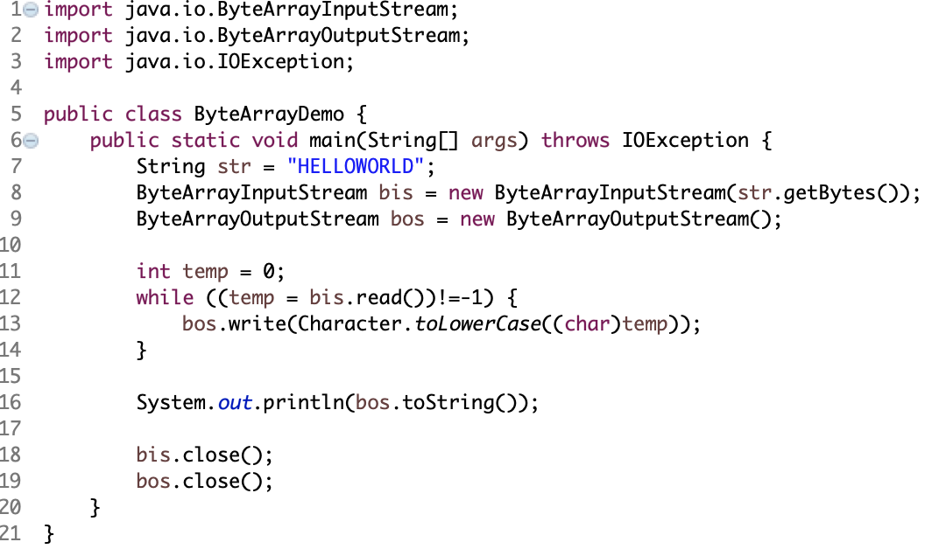
ByteArray Stream
Input and output in previous streams are from external files, whilst ByteArray Stream for reading and writing is directly into memory
ByteArrayInputStream
ByteArrayOutputStream

Slide 24
Pipeline Stream
Mainly used for connection/communication between two threads
PipedInputStream
PipedOutputStream
public void connect(PipedInputStream snk) throws IOException

Slide 25
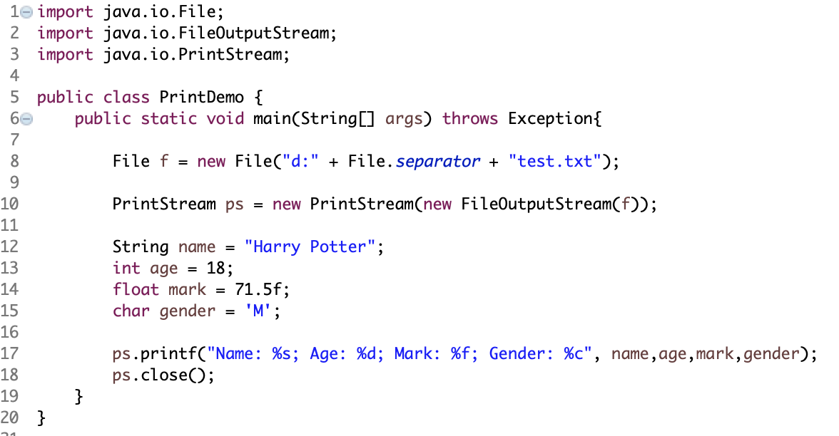
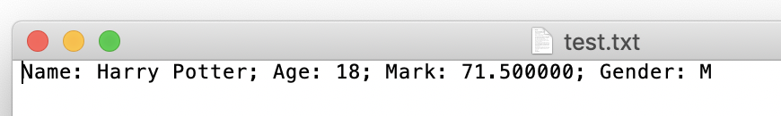
Print Stream
Output ONLY
Byte-based Print Stream
PrintStream Class
Char-based Print Stream
PrintWriter Class
printf()
%s for String
%d for integer
%f for float
%c for char

Slide 26
Summary
Persistent data can be stored in files on the local disk.
To do this, you need to use the I/O features of Java provided in package java.io
The I/O model is based around streams of data and is general enough to be used for all types of I/O, including networked I/O.
Various Streams.

